Slide 1
Microservices and DevOps
Scalable Microservices
Resilience4J: A Stability Pattern library
Henrik Bærbak Christensen

Slide 2

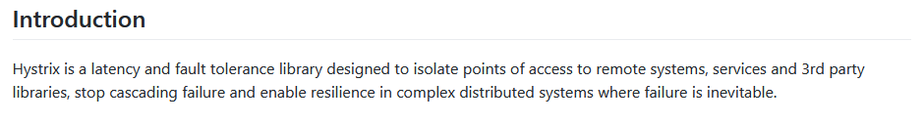
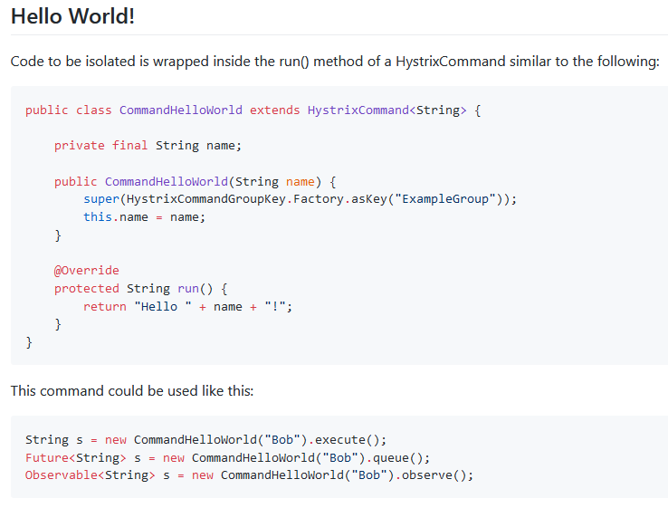

History
Hystrix,
Developed by NetFlix
Central Hystrix abstraction:
The Command pattern
Make a method into an object
Disclaimer
I have never used it…

Slide 3
Resilience4J
… is
A lightweight, easy-to-use fault tolerance library inspired by Hystrix, but designed for Java 8 and functional programming.
You can pick and choose just the piece you want
CircuitBreaker: Nygard’s pattern in it’s frequency form
Bulkhead: Limit number of concurrent executions
RateLimiter: Limit rate of requests (or queue them)
Retry: Retry call N times with M mS delay between
TimeLimiter: Nygard’s Fail Fast pattern
Cache: You guessed it ☺

Slide 4
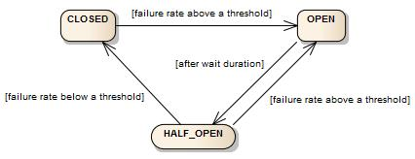
Circuit Breaker
The standard state machine
Not count of failures, but failure rate
Two ways of calculating rate
Count-based sliding window
One out of last 5 calls failed = 20% failure rate
Time-based sliding window
5 seconds is 5 ‘1 second epoch buckets’
Each bucket aggregate all calls that second and mark ‘pass/fail’
20% failure rate = 1 out of 5 last buckets was a fail

Slide 5
Circuit Breaker
Closed to Open state transitions happen when
Failure rate is exceeded
As well as slow response rate exceeded
So both ‘failed’ and ‘slow’ executions are recorded!
If call to CB in OPEN state, then
CallNotPermittedException is thrown
Catch it to provide the ‘safe failure mode’ response

Slide 6
Circuit Breaker
Half Open state
You can configure the number of calls to make in half open
Contrast Nygard, who has this number at a single call
Example: Half Open calls set to 3
Three calls are made, and standard failure rate computation then is used to determine state change to either Open or Closed
Forth and consecutive calls are handled as Open calls
Throw the CallNotPermittedException exception

Slide 7
Circuit Breaker
Note: The CB does NOT itself implement time out
Setting the slow response time to 10 seconds
slowCallDurationThreshold
Will still make the CB wait for 8 minutes, if the call really takes 8 minutes to complete!
Solution
Use your REST client library’s time out facilities
Or – use the Resilience4J’s TimeLimiter

Slide 8
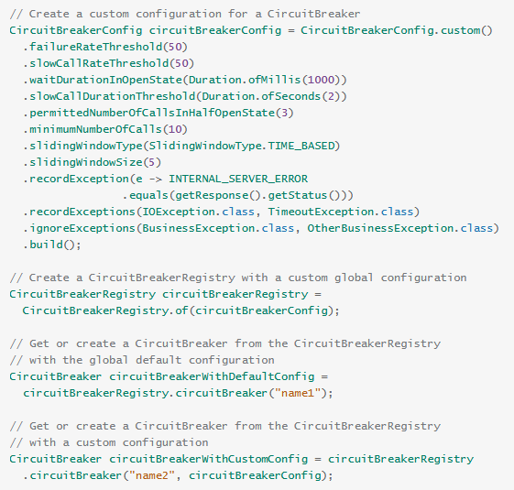
Circuit Breaker
CB can be configured in a zillion ways ☹ ☺

Slide 9
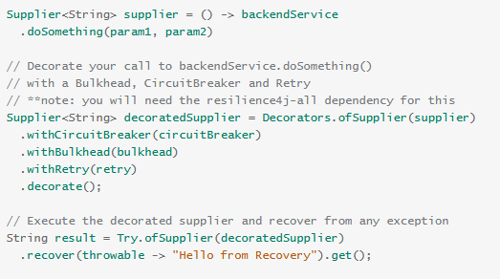
“Decorators”
Resilience4J relies on the functional version of Decorator(*) pattern, using Java8 functional abstractions
Meaning they can be ‘onion-like’ wrapped
Integration point
Decorators introduce CB, bulkhead, and retry
Actual call site

Slide 10
“Decorators”
They call it ‘decorators’ but it find it is actually the ‘proxy’ pattern
Decorator: Add additional responsibilities to object
Proxy: Provide a placeholder that controls access to object
Anyway – they are behaviorally equivalent…

Slide 11

Coding It
Each integration point (= call to remote service) must be defined as a Java8 functional abstraction
Callable, Supplier, Function, …
Example: QuoteService’s getQuote method
Declare a ‘Function’
And create it as a decorator on a real quote service call

Slide 12
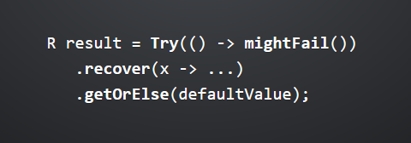
Coding It
The functional approach and reliance on Varv library is a bit of a ‘challenge’ for old-school procedural coders like me…
But there is something about it

Slide 13
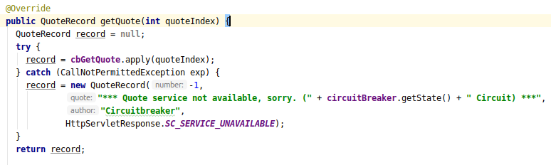
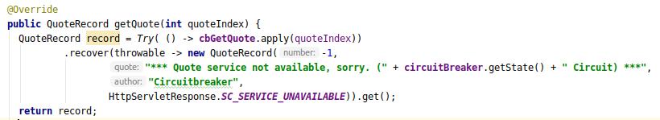
Example
Old-school = I wrote this initially ☺
The Varv way has quite some value, though ☺
The actual remote call

Slide 14
Monitorability
Resilience/Stability/Availability Monitoring

Slide 15
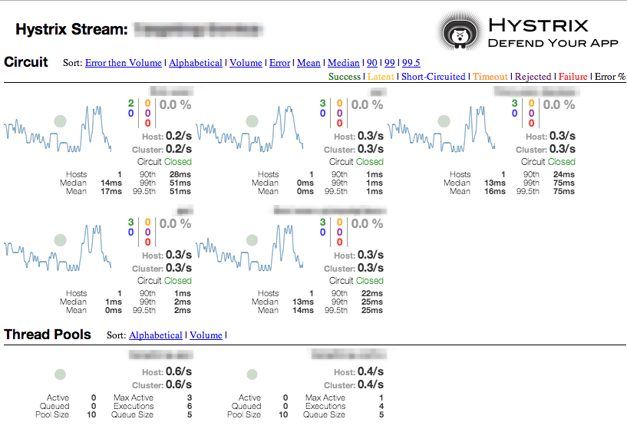
Monitoring your CBs
CB states tell a lot about the state of your architecture

Slide 16
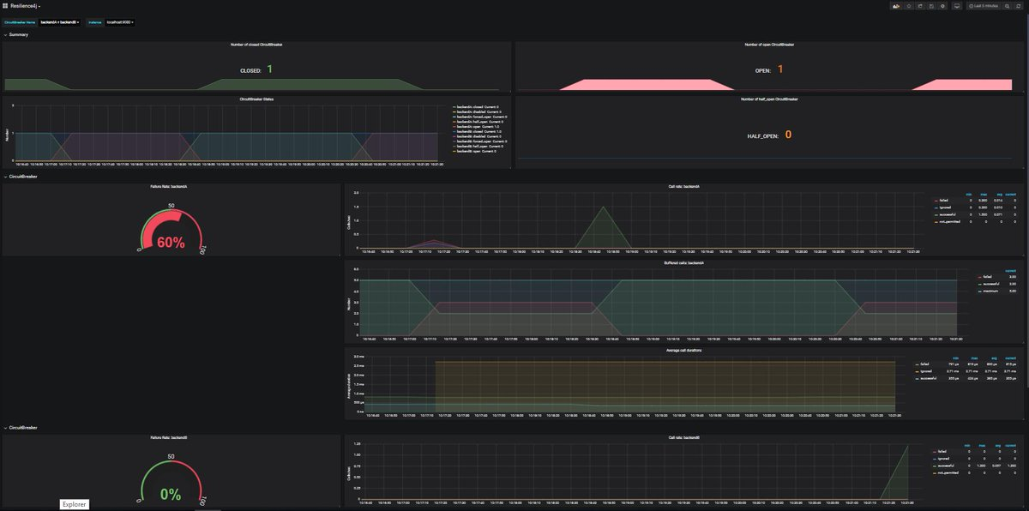
Can Do
Resilience4J integrate with Micrometer and Grafana

Slide 17
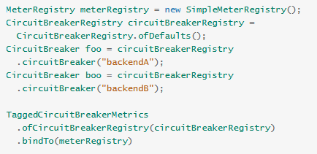
Micrometer
Micrometer is Dropwizard’s replacement
They say themselves ☺
Micrometer integrate with Humio ☺
Probably have to have the paid version…
The Newman Data Pumps pattern (p 96 ff, ‘modernization’ slides)

Slide 18
Summary
Cool stuff…
Avoid a lot of hand-coding myself
But
Documentation assumes you know your patterns beforehand
Delve into tech detail, misses the intro and big picture ☹
A bit of a learning curve
Zillion handles to crank
And forced to learn bits of Java8 functional programming style…

